Slide 1
Peg Game CSCI 352 Project
By William Hayes & Jackson Horton

Slide 2

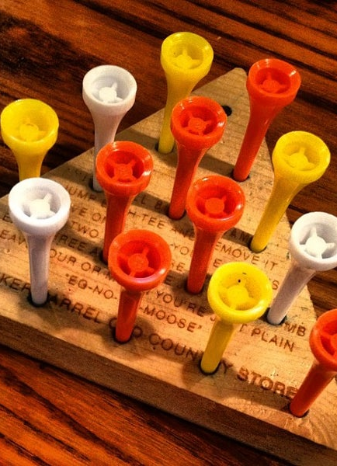
Introduction
What is this project about?
Why a peg game from Cracker Barrel?
Background information
Rules
Tools used

Slide 3


Implementation
What did we use?
Libraries?
Software tools?
Design patterns
Why a Factory Method pattern?
Why a Strategy pattern?

Slide 4

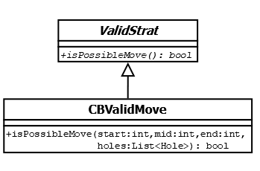



UML Diagrams

Slide 5
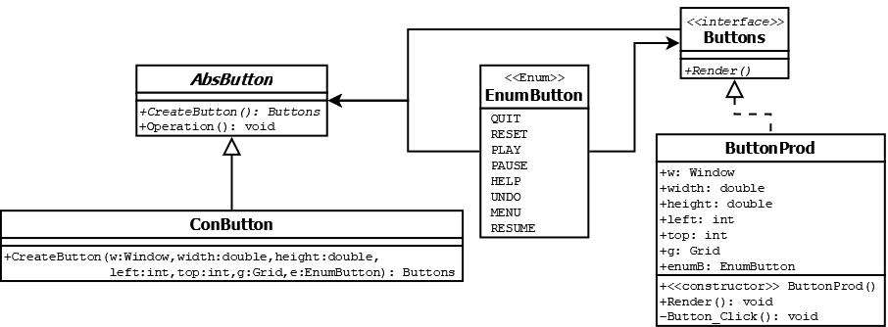
UML Diagrams

Slide 6
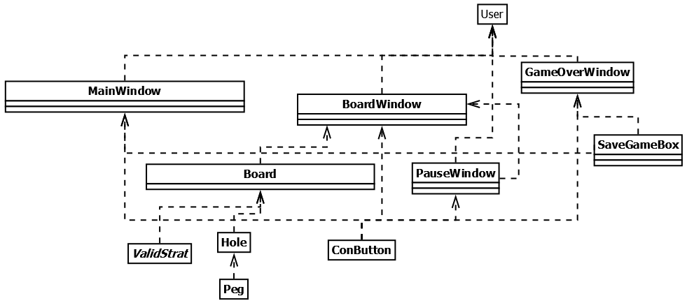
UML Diagram

Slide 7
Demonstration
https://drive.google.com/file/d/1bJlE4Xigfu7IOa3WcKLTsjBpAgZAHmo8/view?usp=share_link

Slide 8
Future Work
Will we implement all of the stretch goals?
What will this project be used for?
Will this be turned into a proper app someday?

